Slide 1
Recurrent Neural Networks

Slide 2
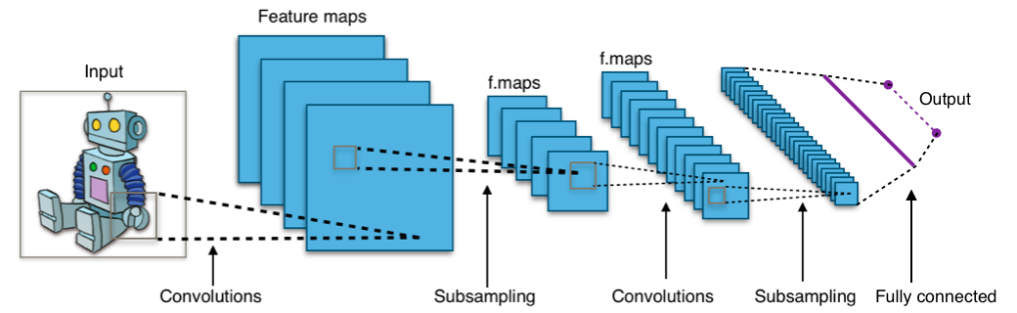
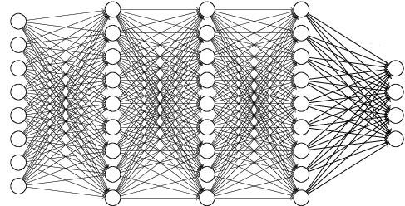
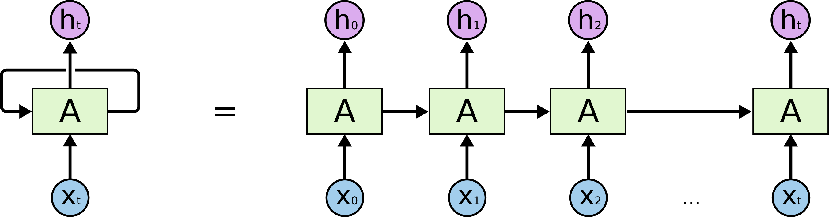
Recurrent Neural Network
Type of Deep Neural Network
Dense Network (=Fully-connected Neural Network)
Convolutional Neural Network
Recurrent Neural Network
…
<Convolutional Neural Network>
<Dense Network>
<Recurrent Neural Network>

Slide 3
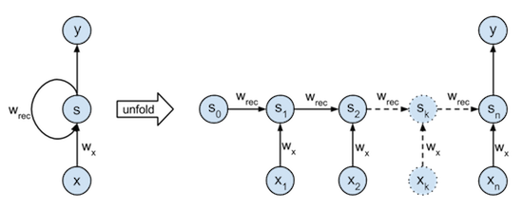
Recurrent Neural Network
What is the Recurrent Neural Network?

Slide 4
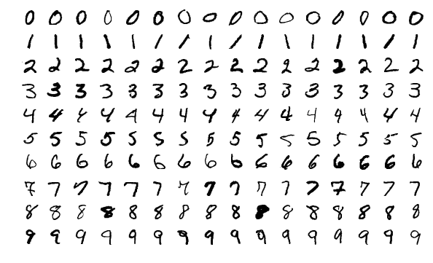
RNN for MNIST
MNIST Dataset
Large data of handwritten digits that is commonly used for training various image processing systems and machine learning
It contains 60,000 training images and 10,000 testing images (28 X 28 pixel)

Slide 5
RNN for MNIST
Preparation
import tensorflow as tf import os os.environ['CUDA_VISIBLE_DEVICES'] = "0" config = tf.ConfigProto() config.gpu_options.per_process_gpu_memory_fraction = 0.4
from tensorflow.examples.tutorials.mnist import input_data mnist = input_data.read_data_sets("./mnist/data/", one_hot=True) X = tf.placeholder(tf.float32, [None, 28, 28]) Y = tf.placeholder(tf.float32, [None, 10])
[10]
[28]
[28]
[28]
[28]

Slide 6
RNN for MNIST
Set Model (1)
W = tf.Variable(tf.random_normal([128, 10])) b = tf.Variable(tf.random_normal([10]))
[128]
[128]
[128]
[128]

Slide 7
RNN for MNIST
Set Model (2)
# BasicRNNCell,BasicLSTMCell,GRUCell cell = tf.nn.rnn_cell.BasicRNNCell(128) outputs, states = tf.nn.dynamic_rnn(cell, X, dtype=tf.float32)

Slide 8
RNN for MNIST
Set Model (3)
outputs = tf.transpose(outputs, [1, 0, 2]) outputs = outputs[-1] model = tf.nn.softmax(tf.matmul(outputs, W) + b)
(batch_size, n_step, output_dim)
Transpose [1, 0, 2]
(n_step, batch_size, output_dim)

Slide 9
RNN for MNIST
Optimize and Accuracy
cost = -tf.reduce_mean(Y*tf.log(tf.clip_by_value(model,1e-10,1.0))) optimizer = tf.train.AdamOptimizer(0.001).minimize(cost)
is_correct = tf.equal(tf.argmax(model, 1), tf.argmax(Y, 1)) accuracy = tf.reduce_mean(tf.cast(is_correct, tf.float32))

Slide 10
RNN for MNIST
Run!
Epoch: 0001 Avg. cost = 0.055
Epoch: 0002 Avg. cost = 0.024
Epoch: 0003 Avg. cost = 0.018
Epoch: 0004 Avg. cost = 0.015
Epoch: 0005 Avg. cost = 0.014
Epoch: 0006 Avg. cost = 0.012
Epoch: 0007 Avg. cost = 0.011
Epoch: 0008 Avg. cost = 0.011
Epoch: 0009 Avg. cost = 0.010
Epoch: 0010 Avg. cost = 0.010
Epoch: 0011 Avg. cost = 0.009
Epoch: 0012 Avg. cost = 0.009
Epoch: 0013 Avg. cost = 0.009
Epoch: 0014 Avg. cost = 0.008
Epoch: 0015 Avg. cost = 0.008
Accuracy: 0.9644002

Slide 11
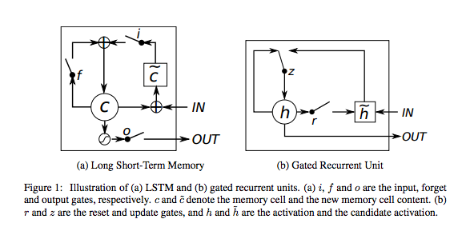
LSTM and GRU
What is LSTM and GRU?
Solving Vanishing Gradient

Slide 12
Practice: Compare LSTM
Code
# BasicRNNCell,BasicLSTMCell,GRUCell cell = tf.nn.rnn_cell.BasicRNNCell(128) outputs, states = tf.nn.dynamic_rnn(cell, X, dtype=tf.float32)
# BasicRNNCell,BasicLSTMCell,GRUCell cell = tf.nn.rnn_cell.BasicLSTMCell(128, forget_bias=1.0) outputs, states = tf.nn.dynamic_rnn(cell, X, dtype=tf.float32)

Slide 13
LSTM for MNIST
Run!
Epoch: 0001 Avg. cost = 0.046
Epoch: 0002 Avg. cost = 0.014
Epoch: 0003 Avg. cost = 0.009
Epoch: 0004 Avg. cost = 0.007
Epoch: 0005 Avg. cost = 0.006
Epoch: 0006 Avg. cost = 0.005
Epoch: 0007 Avg. cost = 0.004
Epoch: 0008 Avg. cost = 0.004
Epoch: 0009 Avg. cost = 0.003
Epoch: 0010 Avg. cost = 0.003
Epoch: 0011 Avg. cost = 0.003
Epoch: 0012 Avg. cost = 0.002
Epoch: 0013 Avg. cost = 0.002
Epoch: 0014 Avg. cost = 0.002
Epoch: 0015 Avg. cost = 0.002
Accuracy: 0.9870001

Slide 14
Practice: Compare GRU
Code
# BasicRNNCell,BasicLSTMCell,GRUCell cell = tf.nn.rnn_cell.BasicRNNCell(128) outputs, states = tf.nn.dynamic_rnn(cell, X, dtype=tf.float32)
# BasicRNNCell,BasicLSTMCell,GRUCell cell = tf.nn.rnn_cell.GRUCell(128) outputs, states = tf.nn.dynamic_rnn(cell, X, dtype=tf.float32)

Slide 15
GRU for MNIST
Run!
Epoch: 0001 Avg. cost = 0.047
Epoch: 0002 Avg. cost = 0.012
Epoch: 0003 Avg. cost = 0.008
Epoch: 0004 Avg. cost = 0.006
Epoch: 0005 Avg. cost = 0.005
Epoch: 0006 Avg. cost = 0.004
Epoch: 0007 Avg. cost = 0.004
Epoch: 0008 Avg. cost = 0.003
Epoch: 0009 Avg. cost = 0.003
Epoch: 0010 Avg. cost = 0.003
Epoch: 0011 Avg. cost = 0.002
Epoch: 0012 Avg. cost = 0.002
Epoch: 0013 Avg. cost = 0.002
Epoch: 0014 Avg. cost = 0.002
Epoch: 0015 Avg. cost = 0.002
Accuracy: 0.9866001

Slide 16
Dropout
Layer 간의 Dropout 적용

Slide 17
Dropout
Code
# BasicRNNCell,BasicLSTMCell,GRUCell cell = tf.nn.rnn_cell.BasicRNNCell(128) outputs, states = tf.nn.dynamic_rnn(cell, X, dtype=tf.float32)
# BasicRNNCell,BasicLSTMCell,GRUCell cell = tf.nn.rnn_cell.BasicRNNCell(128) cell = tf.nn.rnn_cell.DropoutWrapper(cell, output_keep_prob=0.7) outputs, states = tf.nn.dynamic_rnn(cell, X, dtype=tf.float32)

Slide 18
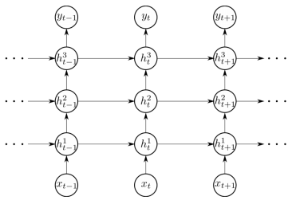
Stacked Recurrent Neural Network
What is the Stacked Recurrent Neural Network?
Several Hidden recurrent layers are stacked to model
Capture hierachical structure

Slide 19
Stacked Recurrent Neural Network
Code
# BasicRNNCell,BasicLSTMCell,GRUCell cell = tf.nn.rnn_cell.BasicRNNCell(128) outputs, states = tf.nn.dynamic_rnn(cell, X, dtype=tf.float32)
cell = [] for i in range(2): cell.append(tf.nn.rnn_cell.BasicLSTMCell(128)) cell = tf.nn.rnn_cell.MultiRNNCell(cell) outputs, states = tf.nn.dynamic_rnn(cell, X, dtype=tf.float32)

Slide 20
Stacked Recurrent Neural Network
Run!
Epoch: 0001 Avg. cost = 0.045
Epoch: 0002 Avg. cost = 0.012
Epoch: 0003 Avg. cost = 0.008
Epoch: 0004 Avg. cost = 0.006
Epoch: 0005 Avg. cost = 0.005
Epoch: 0006 Avg. cost = 0.004
Epoch: 0007 Avg. cost = 0.003
Epoch: 0008 Avg. cost = 0.003
Epoch: 0009 Avg. cost = 0.002
Epoch: 0010 Avg. cost = 0.002
Epoch: 0011 Avg. cost = 0.002
Epoch: 0012 Avg. cost = 0.002
Epoch: 0013 Avg. cost = 0.002
Epoch: 0014 Avg. cost = 0.002
Epoch: 0015 Avg. cost = 0.001
Accuracy: 0.9856001

Slide 21
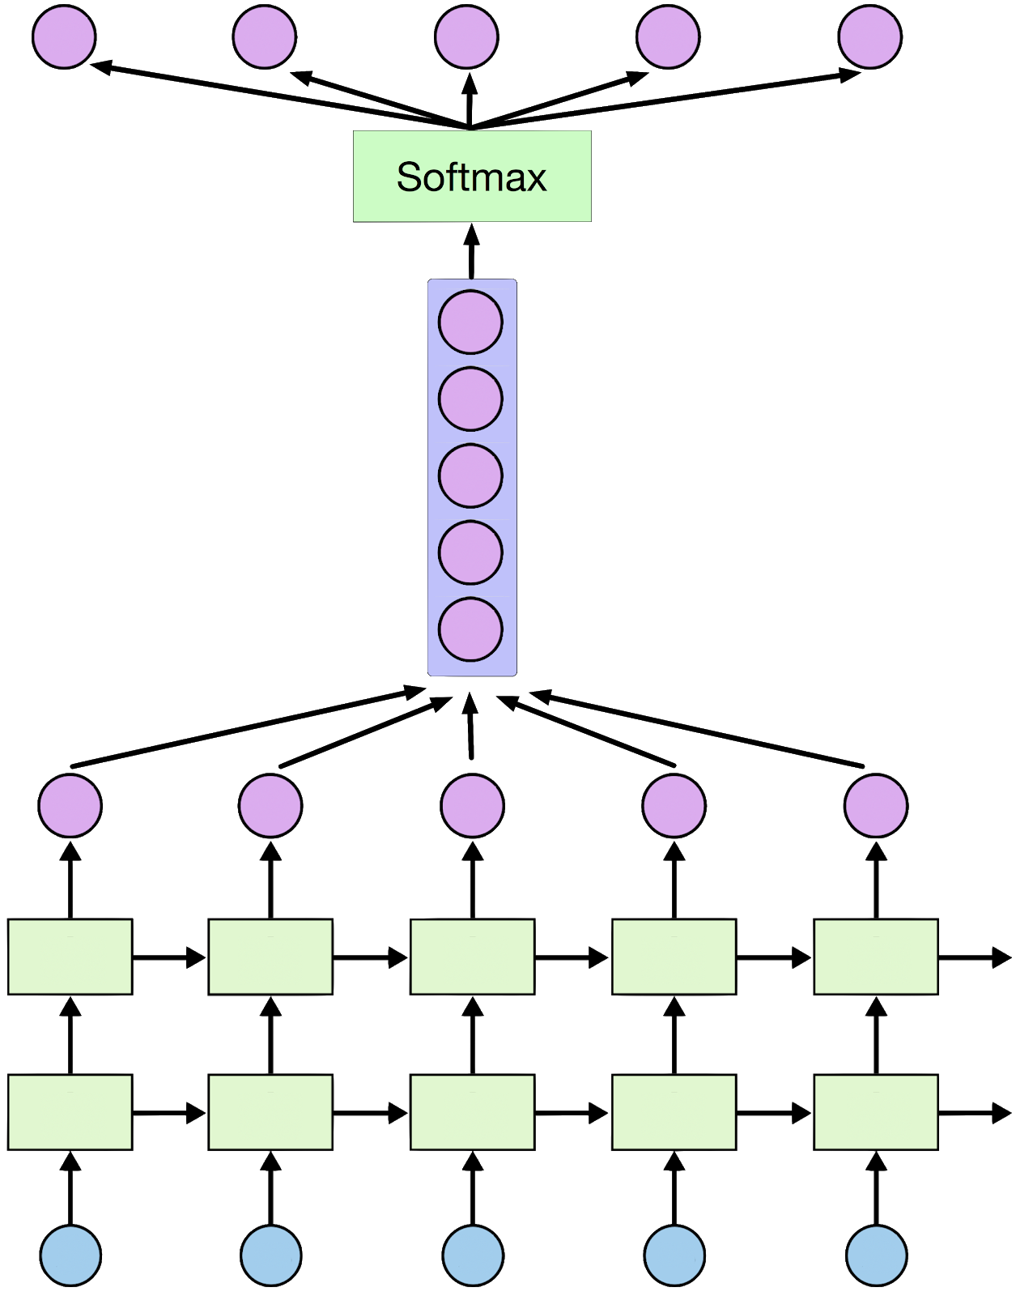
Stacked Recurrent Neural Network
Use all outputs

Slide 22
Stacked Recurrent Neural Network
Code
W = tf.Variable(tf.random_normal([128, 10])) b = tf.Variable(tf.random_normal([10]))
outputs = tf.transpose(outputs, [1, 0, 2]) outputs = outputs[-1] model = tf.nn.softmax(tf.matmul(outputs, W) + b)
W = tf.Variable(tf.random_normal([28 * 128, 10])) b = tf.Variable(tf.random_normal([10]))
outputs = tf.reshape(outputs, [-1, 128 * 28]) model = tf.nn.softmax(tf.matmul(outputs, W) + b)

Slide 23
Stacked Recurrent Neural Network
Run!
Epoch: 0001 Avg. cost = 0.037
Epoch: 0002 Avg. cost = 0.013
Epoch: 0003 Avg. cost = 0.009
Epoch: 0004 Avg. cost = 0.006
Epoch: 0005 Avg. cost = 0.006
Epoch: 0006 Avg. cost = 0.005
Epoch: 0007 Avg. cost = 0.004
Epoch: 0008 Avg. cost = 0.004
Epoch: 0009 Avg. cost = 0.003
Epoch: 0010 Avg. cost = 0.003
Epoch: 0011 Avg. cost = 0.003
Epoch: 0012 Avg. cost = 0.002
Epoch: 0013 Avg. cost = 0.002
Epoch: 0014 Avg. cost = 0.002
Epoch: 0015 Avg. cost = 0.002
Accuracy: 0.9876001

Slide 24
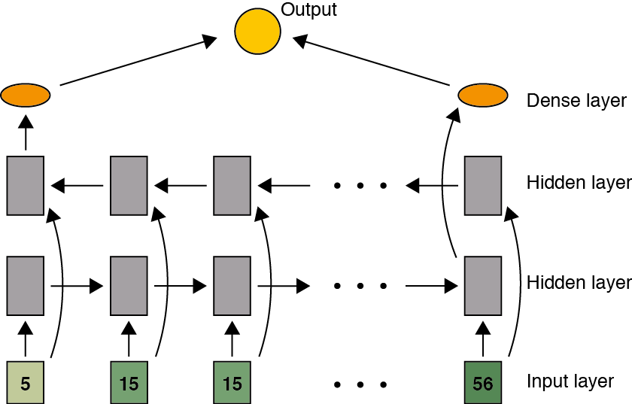
Bidirectional Recurrent Neural Network
What is the Bidirectional Recurrent Neural Network?
In normal time order for one network
In reverse time order for another network
Outputs of the two networks are concatenated at each time step

Slide 25
Bidirectional Recurrent Neural Network
Code
# BasicRNNCell,BasicLSTMCell,GRUCell cell = tf.nn.rnn_cell.BasicRNNCell(128) outputs, states = tf.nn.dynamic_rnn(cell, X, dtype=tf.float32)
cell_fw = tf.nn.rnn_cell.BasicLSTMCell(128) cell_bw = tf.nn.rnn_cell.BasicLSTMCell(128) (outputs_fw, output_bw), states = tf.nn.bidirectional_dynamic_rnn(cell_fw, cell_bw, X, dtype=tf.float32) outputs = tf.concat([outputs_fw, output_bw], axis = -1)
t1 = [[1, 2, 3], [4, 5, 6]] t2 = [[7, 8, 9], [10, 11, 12]] tf.concat([t1, t2], 0) # [[1, 2, 3], [4, 5, 6], [7, 8, 9], [10, 11, 12]] tf.concat([t1, t2], 1) # [[1, 2, 3, 7, 8, 9], [4, 5, 6, 10, 11, 12]]

Slide 26
Bidirectional Recurrent Neural Network
Run!
Epoch: 0001 Avg. cost = 0.047
Epoch: 0002 Avg. cost = 0.013
Epoch: 0003 Avg. cost = 0.009
Epoch: 0004 Avg. cost = 0.007
Epoch: 0005 Avg. cost = 0.006
Epoch: 0006 Avg. cost = 0.005
Epoch: 0007 Avg. cost = 0.004
Epoch: 0008 Avg. cost = 0.004
Epoch: 0009 Avg. cost = 0.003
Epoch: 0010 Avg. cost = 0.003
Epoch: 0011 Avg. cost = 0.003
Epoch: 0012 Avg. cost = 0.002
Epoch: 0013 Avg. cost = 0.002
Epoch: 0014 Avg. cost = 0.002
Epoch: 0015 Avg. cost = 0.002
Accuracy: 0.9859001

Slide 27
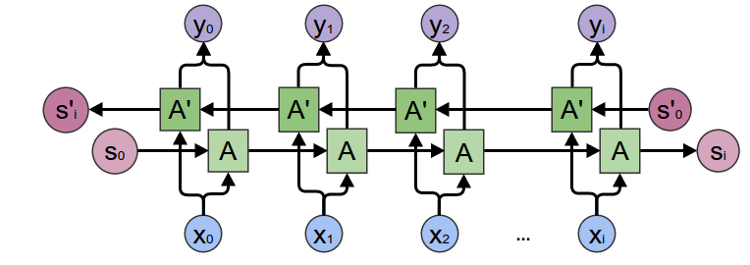
Bidirectional Recurrent Neural Network
What is the Bidirectional Recurrent Neural Network?
In normal time order for one network
In reverse time order for another network
Outputs of the two networks are concatenated at each time step

Slide 28
Bidirectional Recurrent Neural Network
Code
W = tf.Variable(tf.random_normal([128, 10])) b = tf.Variable(tf.random_normal([10]))
outputs = tf.transpose(outputs, [1, 0, 2]) outputs = outputs[-1] model = tf.nn.softmax(tf.matmul(outputs, W) + b)
W = tf.Variable(tf.random_normal([256 * 28, 10])) b = tf.Variable(tf.random_normal([10]))
outputs = tf.reshape(outputs, [-1, 256 * 28]) model = tf.nn.softmax(tf.matmul(outputs, W) + b)

Slide 29
Bidirectional Recurrent Neural Network
Run!
Epoch: 0001 Avg. cost = 0.048
Epoch: 0002 Avg. cost = 0.017
Epoch: 0003 Avg. cost = 0.012
Epoch: 0004 Avg. cost = 0.010
Epoch: 0005 Avg. cost = 0.008
Epoch: 0006 Avg. cost = 0.007
Epoch: 0007 Avg. cost = 0.006
Epoch: 0008 Avg. cost = 0.005
Epoch: 0009 Avg. cost = 0.004
Epoch: 0010 Avg. cost = 0.005
Epoch: 0011 Avg. cost = 0.004
Epoch: 0012 Avg. cost = 0.003
Epoch: 0013 Avg. cost = 0.003
Epoch: 0014 Avg. cost = 0.003
Epoch: 0015 Avg. cost = 0.002
Accuracy: 0.9847001

